Slide 1



NUTRITION FOR SOCCER
Erica Stephens
Accredited Sports Dietitian
BAppSc, MNutrDiet, IOC Dip Sport Nutr

Slide 2
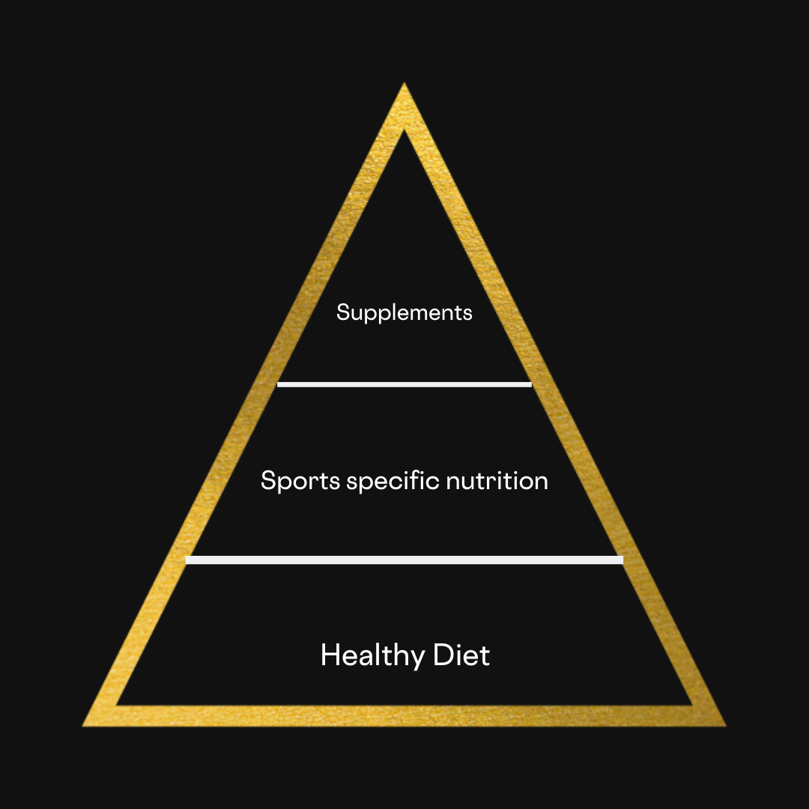

Foundation for Success
Adequate quantities

Slide 3
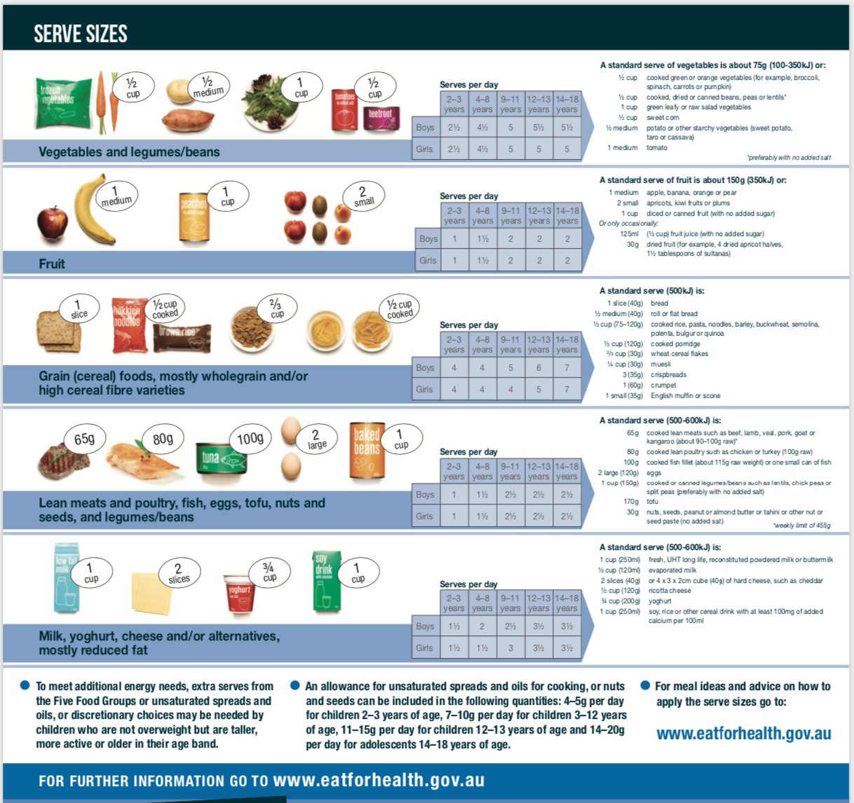
The five food groups
Vitamins
Minerals
Antioxidants
Dietary Fibre
Vitamins
Minerals
Antioxidants
Dietary Fibre
B-vitamins
Carbohydrate
Dietary Fibre
Iron
Zinc
Protein
Calcium
Protein
Magnesium
Potassium

Slide 4
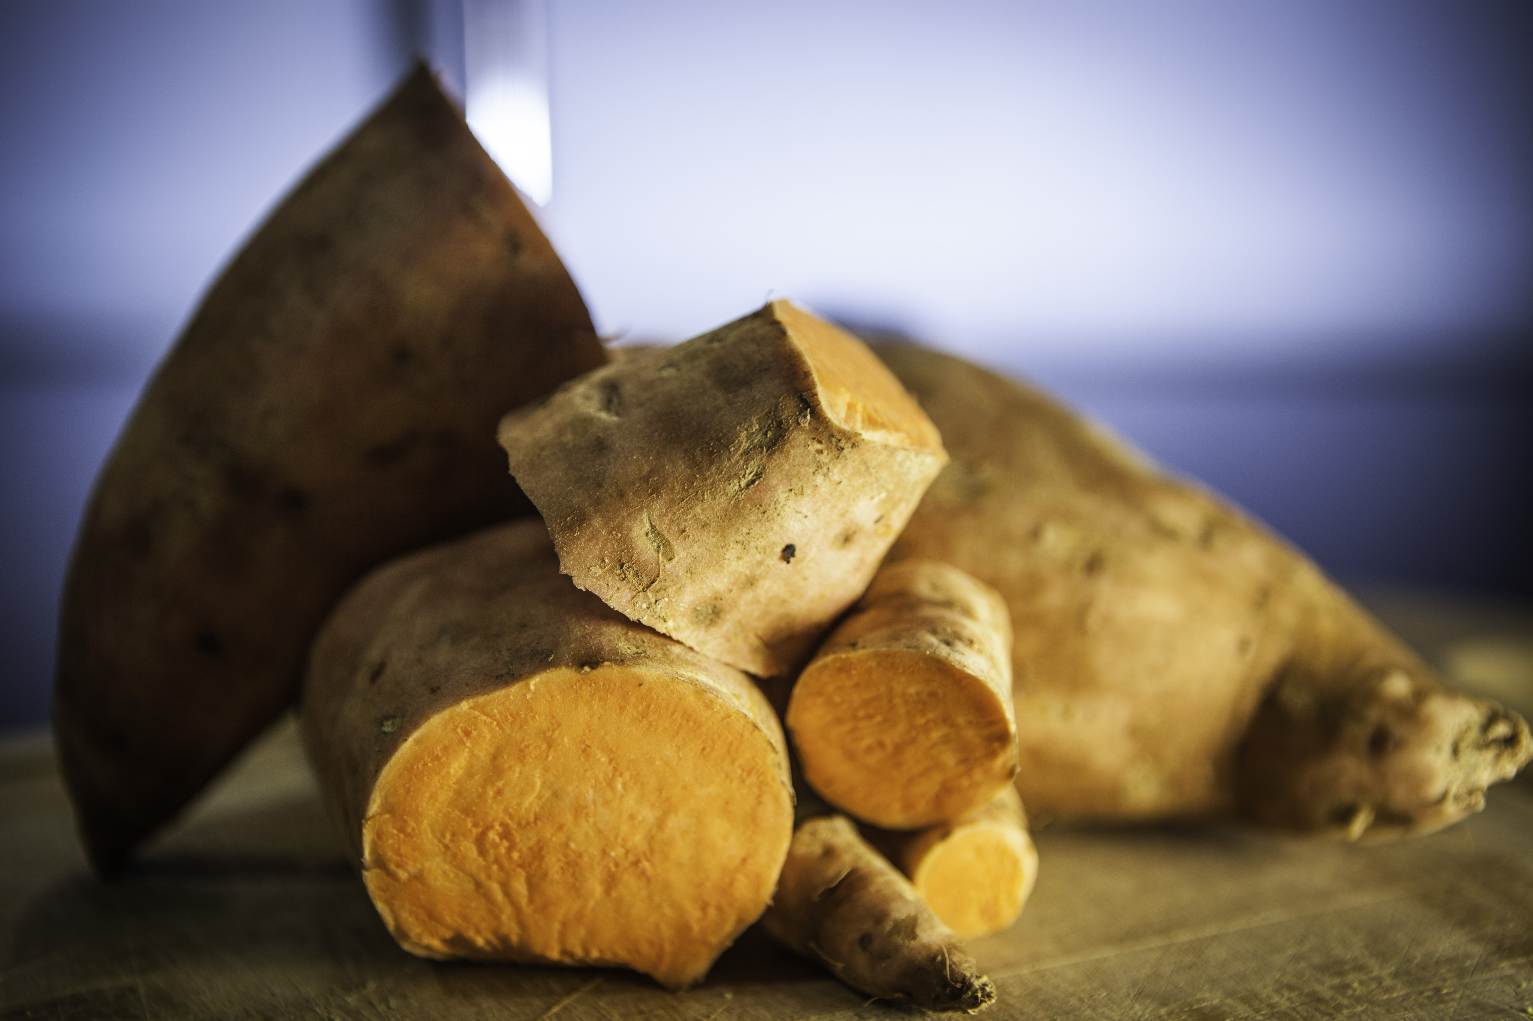
vegetables
 | 12-13 Years | 14-18 Years | 19-50 Years
Boys | 5.5 | 5.5 | 6
Girls | 5 | 5 | 5
one serve
_½ cup cooked vegetables
_½ cup beans
_1 cup raw salad vegetables
_½ cup sweet corn
_½ medium potato
_1 medium tomato
Notes:
If we look at it in more detail, starting with the Vegetable group.

Slide 5
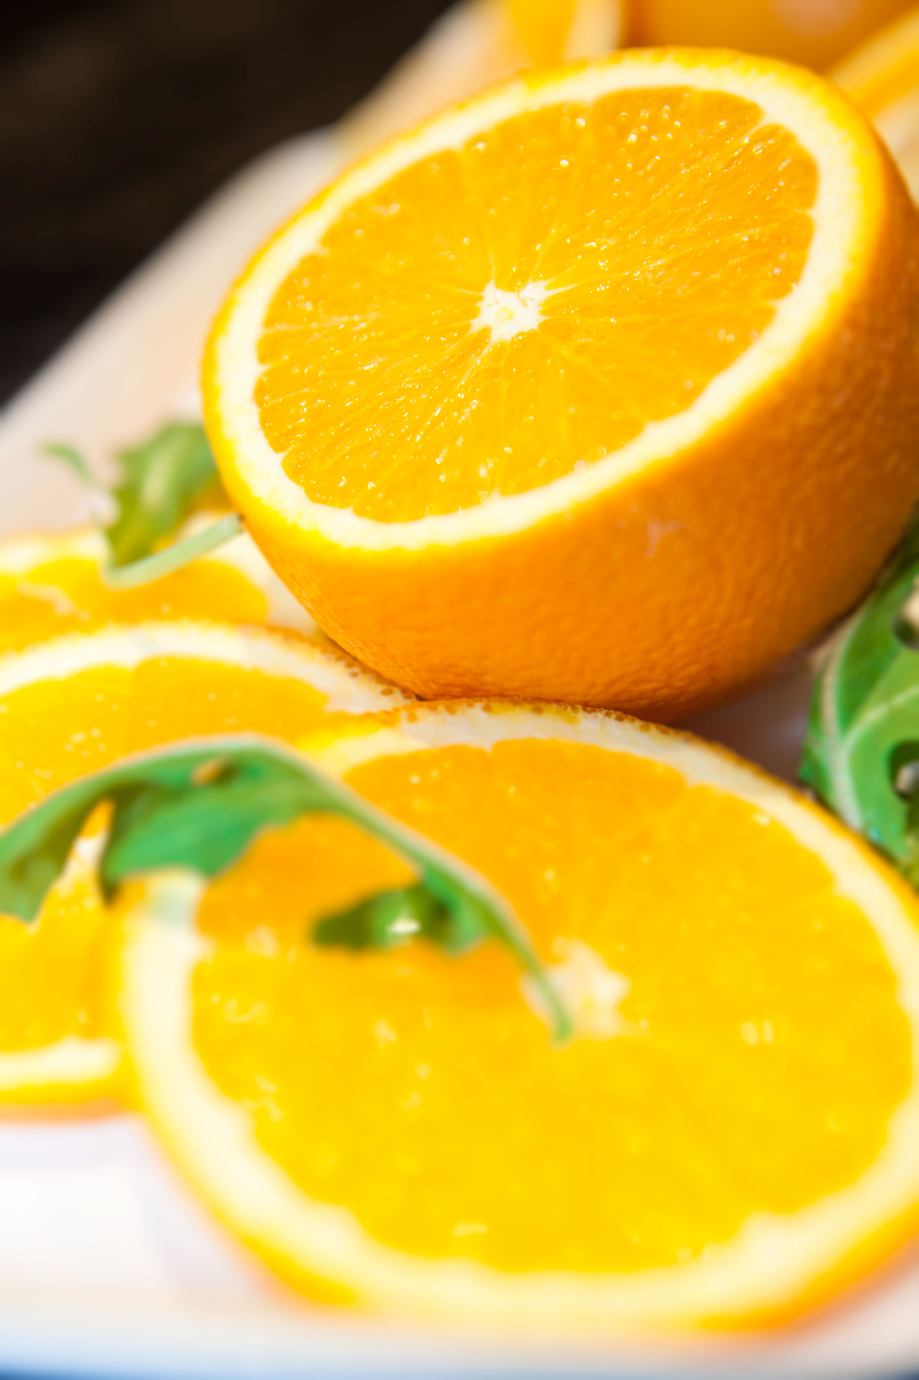
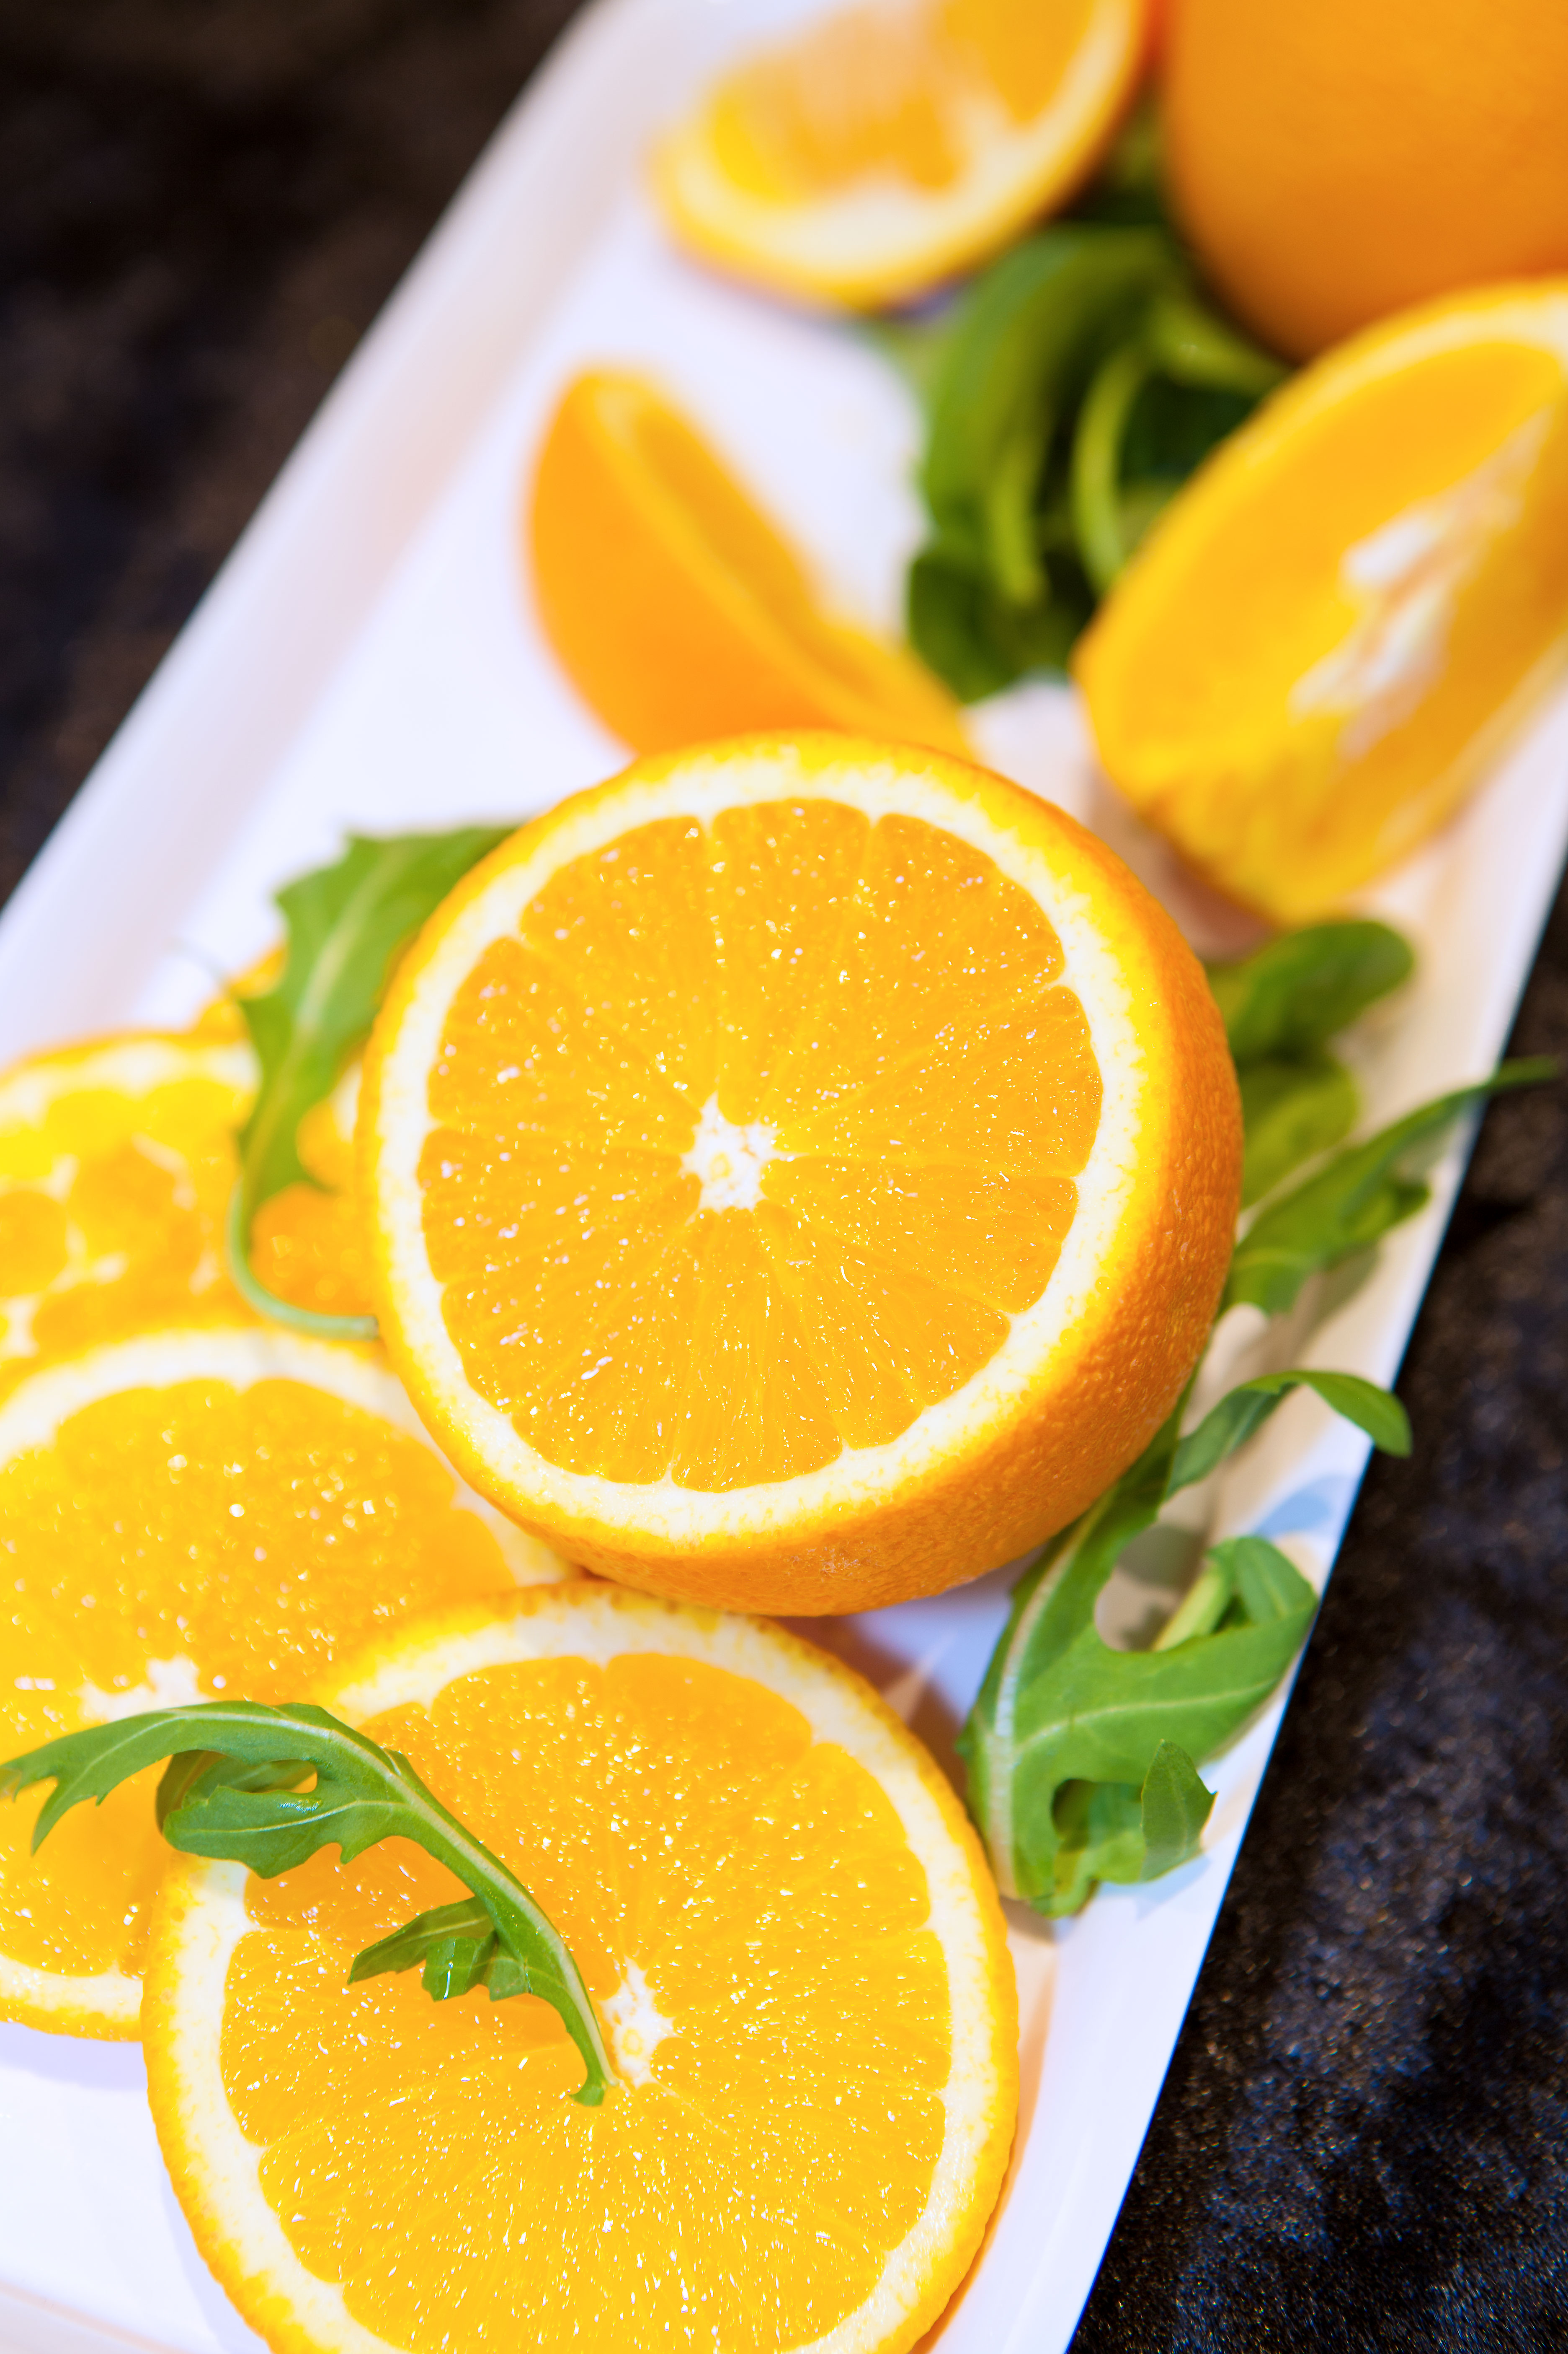
fruit
one serve
_1 medium apple, banana
_2 small apricots, kiwi or plums
_1 cup diced or canned fruit
(with no added sugar)
Or only occasionally:
_125ml fruit juice
_30g dried fruit
 | 12-13 Years | 14-18 Years | 19-50 Years
Boys | 2 | 2 | 2
Girls | 2 | 2 | 2

Slide 6
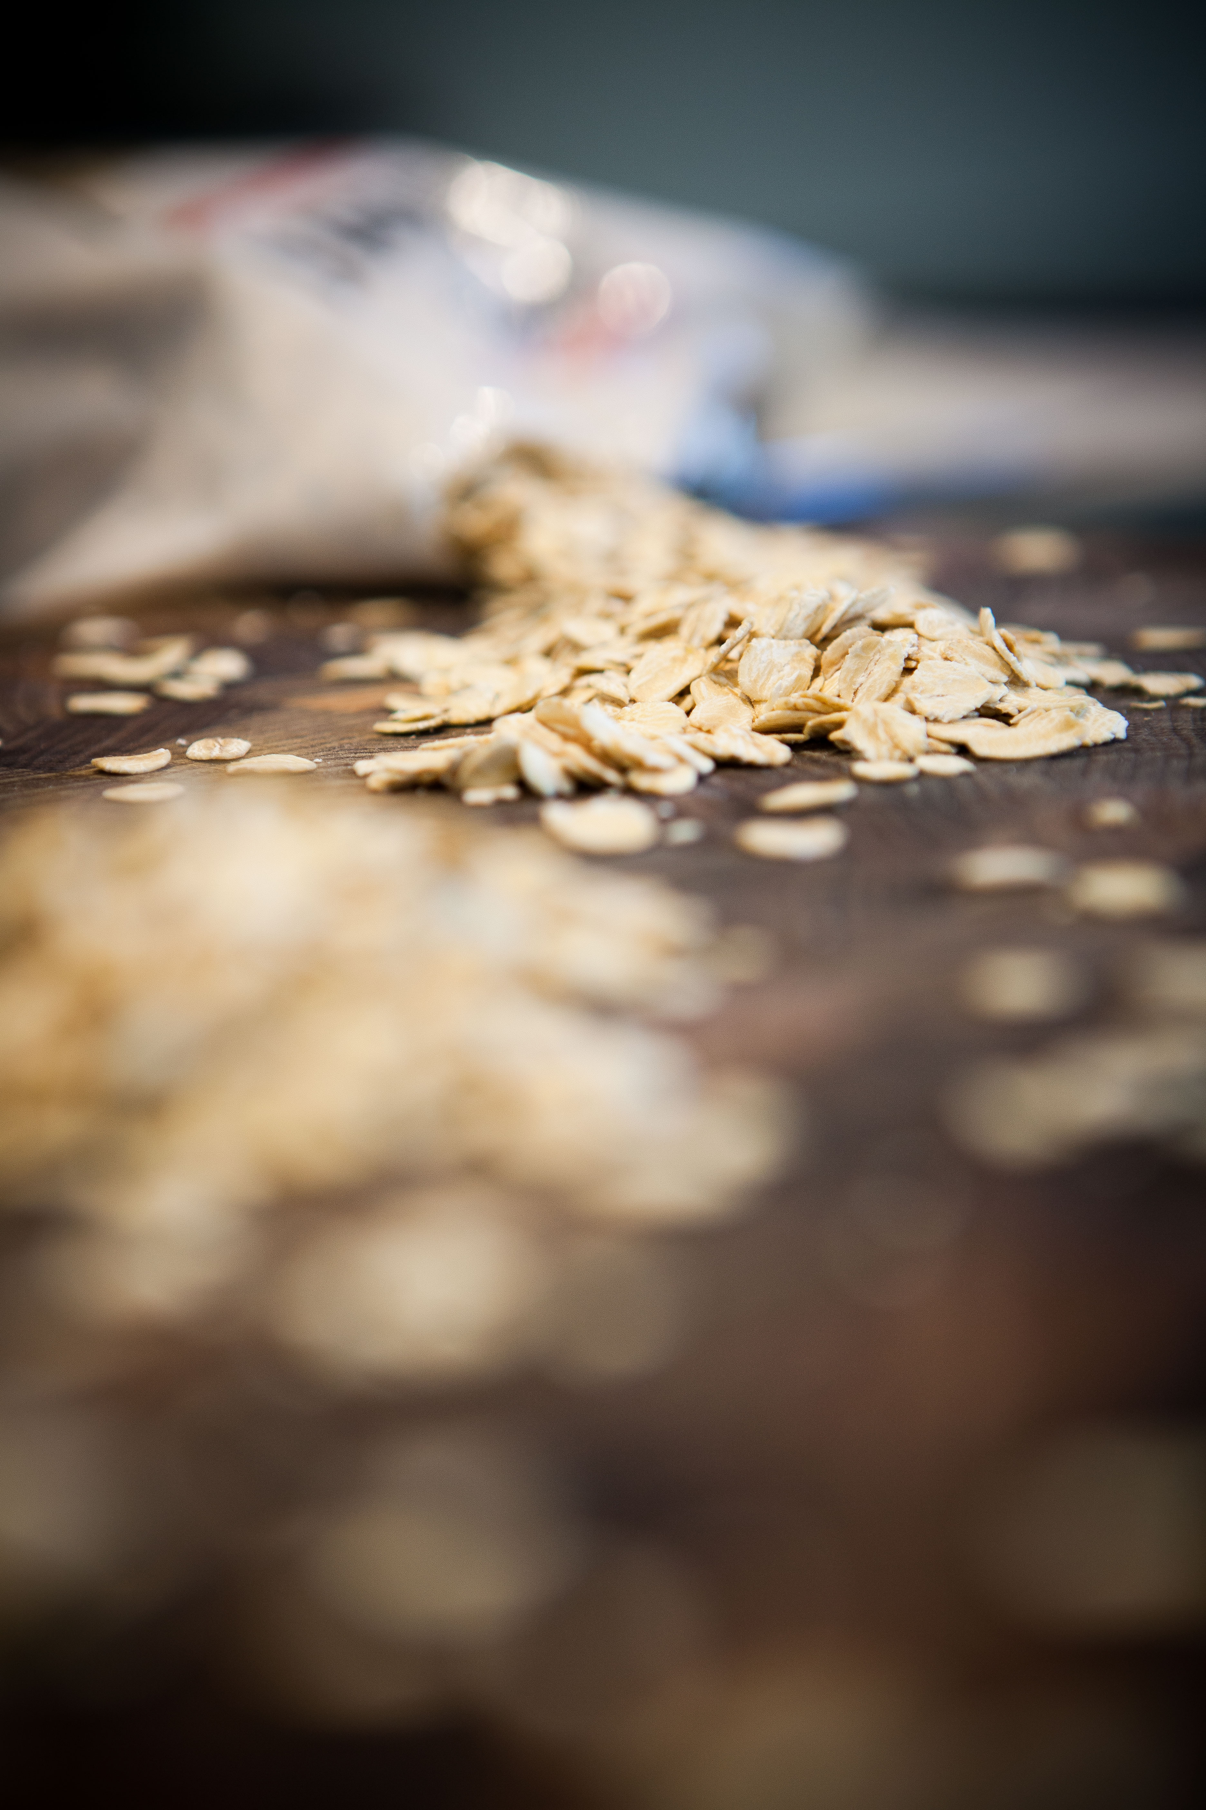
grains/cereals
one serve
_1 slice bread
_½ medium roll or flat bread
_½ cup cooked rice, pasta, quinoa
_½ cup cooked porridge
_2/3 cup wheat cereal flakes
_¼ cup muesli
_3 crispbreads, 1 crumpet, 1 english muffin
 | 12-13 Years | 14-18 Years | 19-50 Years
Boys | 6 | 7 | 6
Girls | 5 | 7 | 6

Slide 7
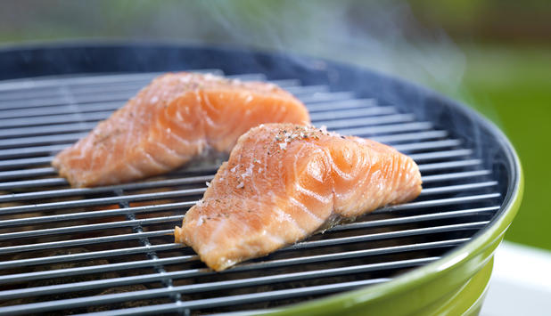
meat/meat alternatives
 | 12-13 Years | 14-18 Years | 19-50 Years
Boys | 2.5 | 2.5 | 3
Girls | 2.5 | 2.5 | 2.5
one serve
_65g cooked lean meat
_80g cooked lean poultry
_100g cooked fish
_2 large eggs
_1 cup cooked beans
_170g tofu
_30g nuts, seeds

Slide 8

dairy
one serve
_1 cup (250ml) milk
_½ cup evaporated milk
_2 slices or 40g hard cheese
_½ cup ricotta cheese
_¾ cup yoghurt
_1 cup soy milk
 | 12-13 Years | 14-18 Years | 19-50 Years
Boys | 3.5 | 3.5 | 2.5
Girls | 3.5 | 3.5 | 2.5

Slide 9

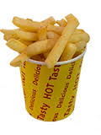
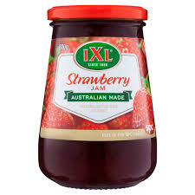

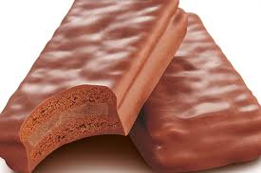
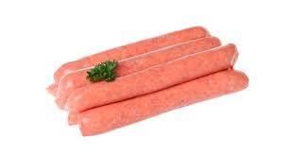


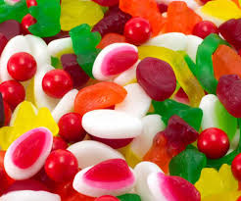
discretionary foods
Infrequent, small quantities
1 donut
2 tbs honey
~12 hot chips
2 tbs jam
2 thin sausages
2 choc biscuits
5-6 lollies
1 can soft drink
5 squares chocolate

Slide 10
Foundation for Success
Adequate quantities

Slide 11
Nutrients in foods
Fuel for the muscle: carbohydrate:
From the grains & cereals and fruit food groups
- e.g. bread, cereal, crackers, muesli, oats, rice, couscous, quinoa, noodles, pasta, fruit
Repair of the muscle: protein
From the meat/meat alternatives and dairy food groups
- e.g. red meats, fish, poultry (chicken and turkey), dairy (milk, yoghurt, cheese), tofu, lentils/beans.

Slide 12
Sport specific nutrition
Pre-training/game: carbohydrate based foods:
- muesli bars
- fruit and yoghurt
- sandwich, wrap or toast w/ honey & banana
- raisin toast with ricotta
- weet-bix or muesli with milk
- popcorn, pretzels, rice crackers
Post-training/game: carbohydrate + protein:
- fruit and yoghurt
- weet-bix or muesli and milk
- chocolate milk
- baked beans on toast
- cheese on toast or cheese sandwich
- chicken, rice, vegetable stirfry
- spaghetti bolognaise (pasta, lean mince, side salad)
- fish, couscous and salad

Slide 13
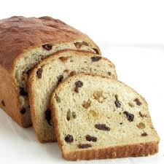

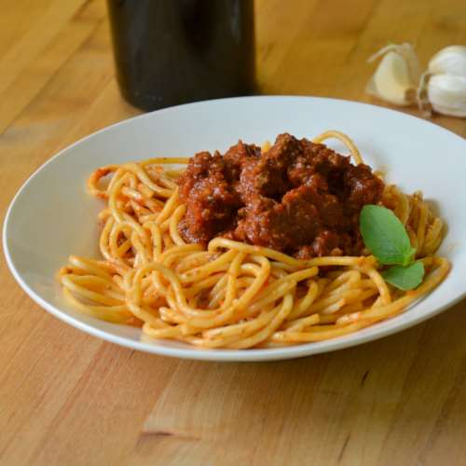
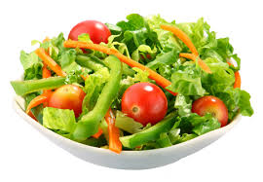
Sport specific nutrition
- training
Pre-training Post-training

Slide 14
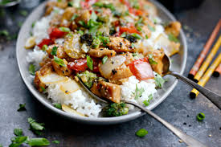
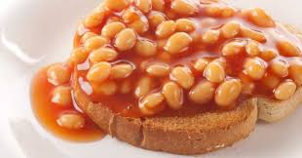
Sport specific nutrition
- training
Pre-training Post-training

Slide 15
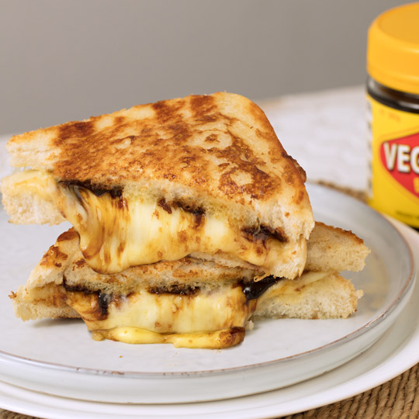
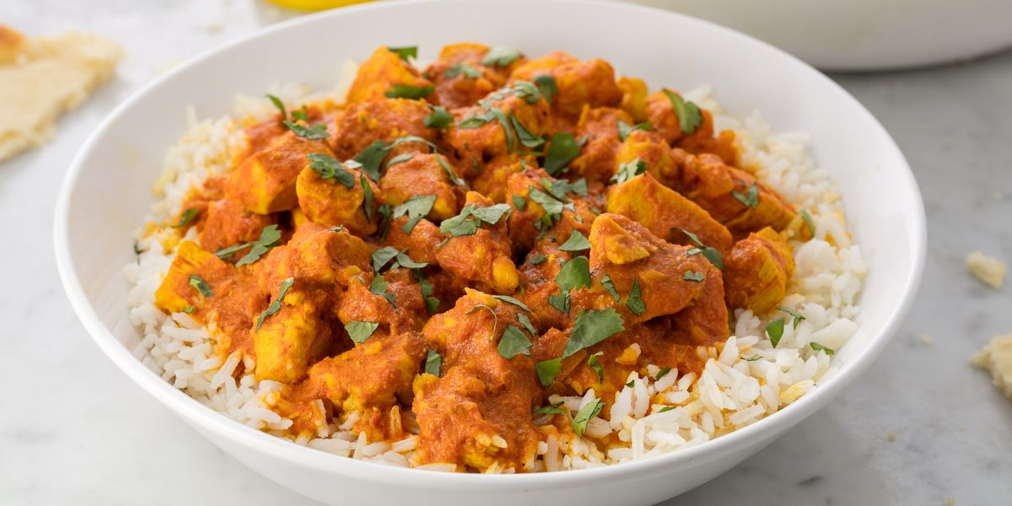
Sport specific nutrition
- training
Pre-training Post-training

Slide 16
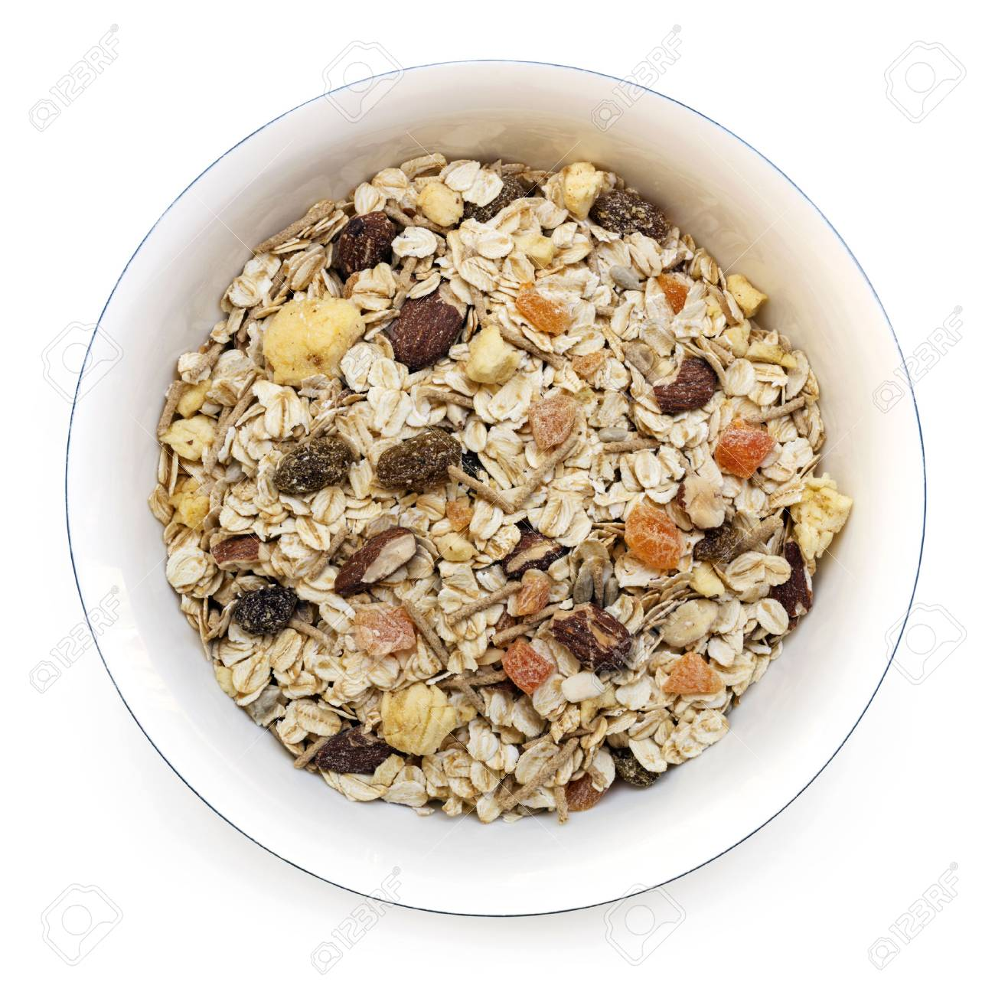


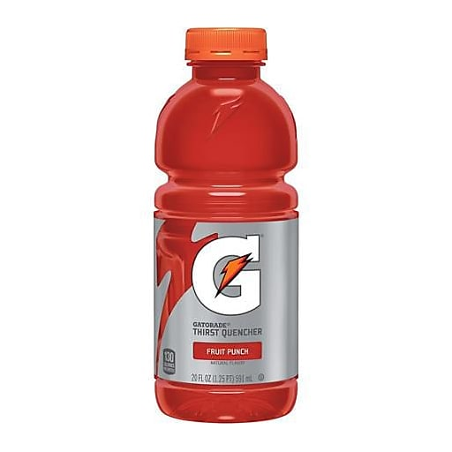
Sport specific nutrition
- game days
OR
Pre-game Half-time Post-game

Slide 17
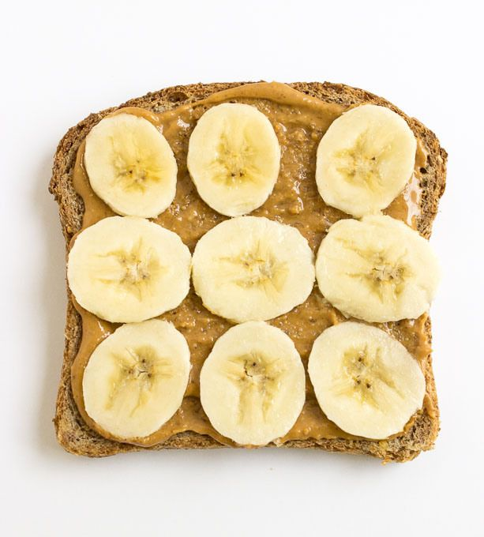
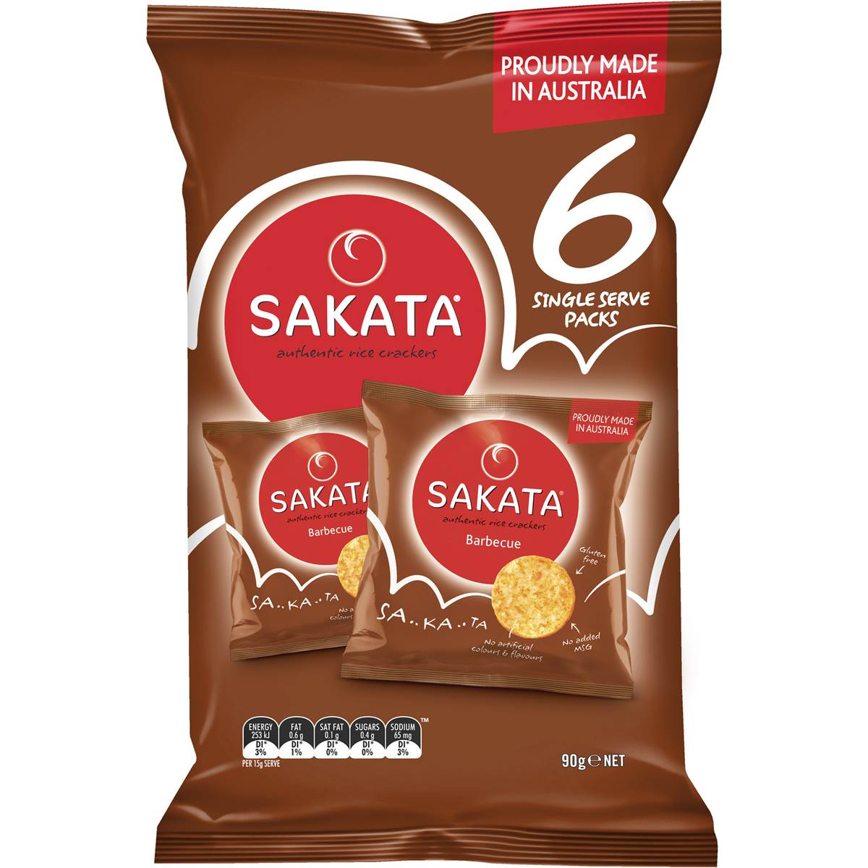
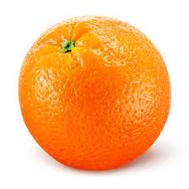
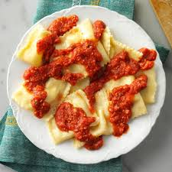
Sport specific nutrition
- game days
OR
Pre-game Half-time Post-game

Slide 18
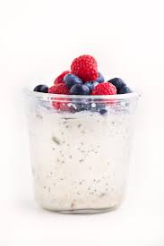
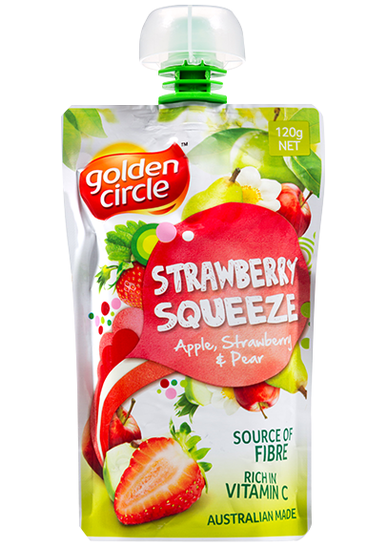
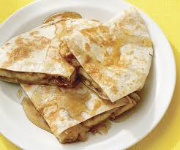
Sport specific nutrition
- game days
OR
Pre-game Half-time Post-game

Slide 19
Matching food intake with output
Non-training day:
Breakfast:
3 weet-bix + milk + banana
Snack:
Yoghurt + apple
Lunch:
Sandwich w/ 2 slices cheese & salad
+ muesli bar
Snack:
2 x Mini popcorn packet
Dinner:
Steak, veggies, potato
Training day:
Breakfast:
6 weet-bix + milk + banana
Snack:
Yoghurt + oats + apple
Lunch:
2 sandwiches w/ 2 slices cheese & salad
+ muesli bar
Snack:
2 x Mini popcorn packet + 2 slices raisin toast with ricotta
Dinner:
Spaghetti bolognaise (pasta based)
Life
Growth
Sport
A time of high energy needs

Slide 20
What I’ve noticed after 10 years
- during the week
- Skipping breakfast or very inadequate breakfast
Not taking enough food to school
Not eating food that is taken to school
Missing afternoon/pre-training snack due to not bringing any or not making time to have it
Making up for a poor day of intake by eating everything in the cupboard/fridge after school

Slide 21
What I’ve noticed after 10 years
- game day
Sleeping in, missing a meal prior to the game
Bacon and eggs for breakfast (low carb)
Game times crossing over a meal time and not re-jigging meal times to accommodate for this
Not eating/drinking anything with carbs at half time

Slide 22
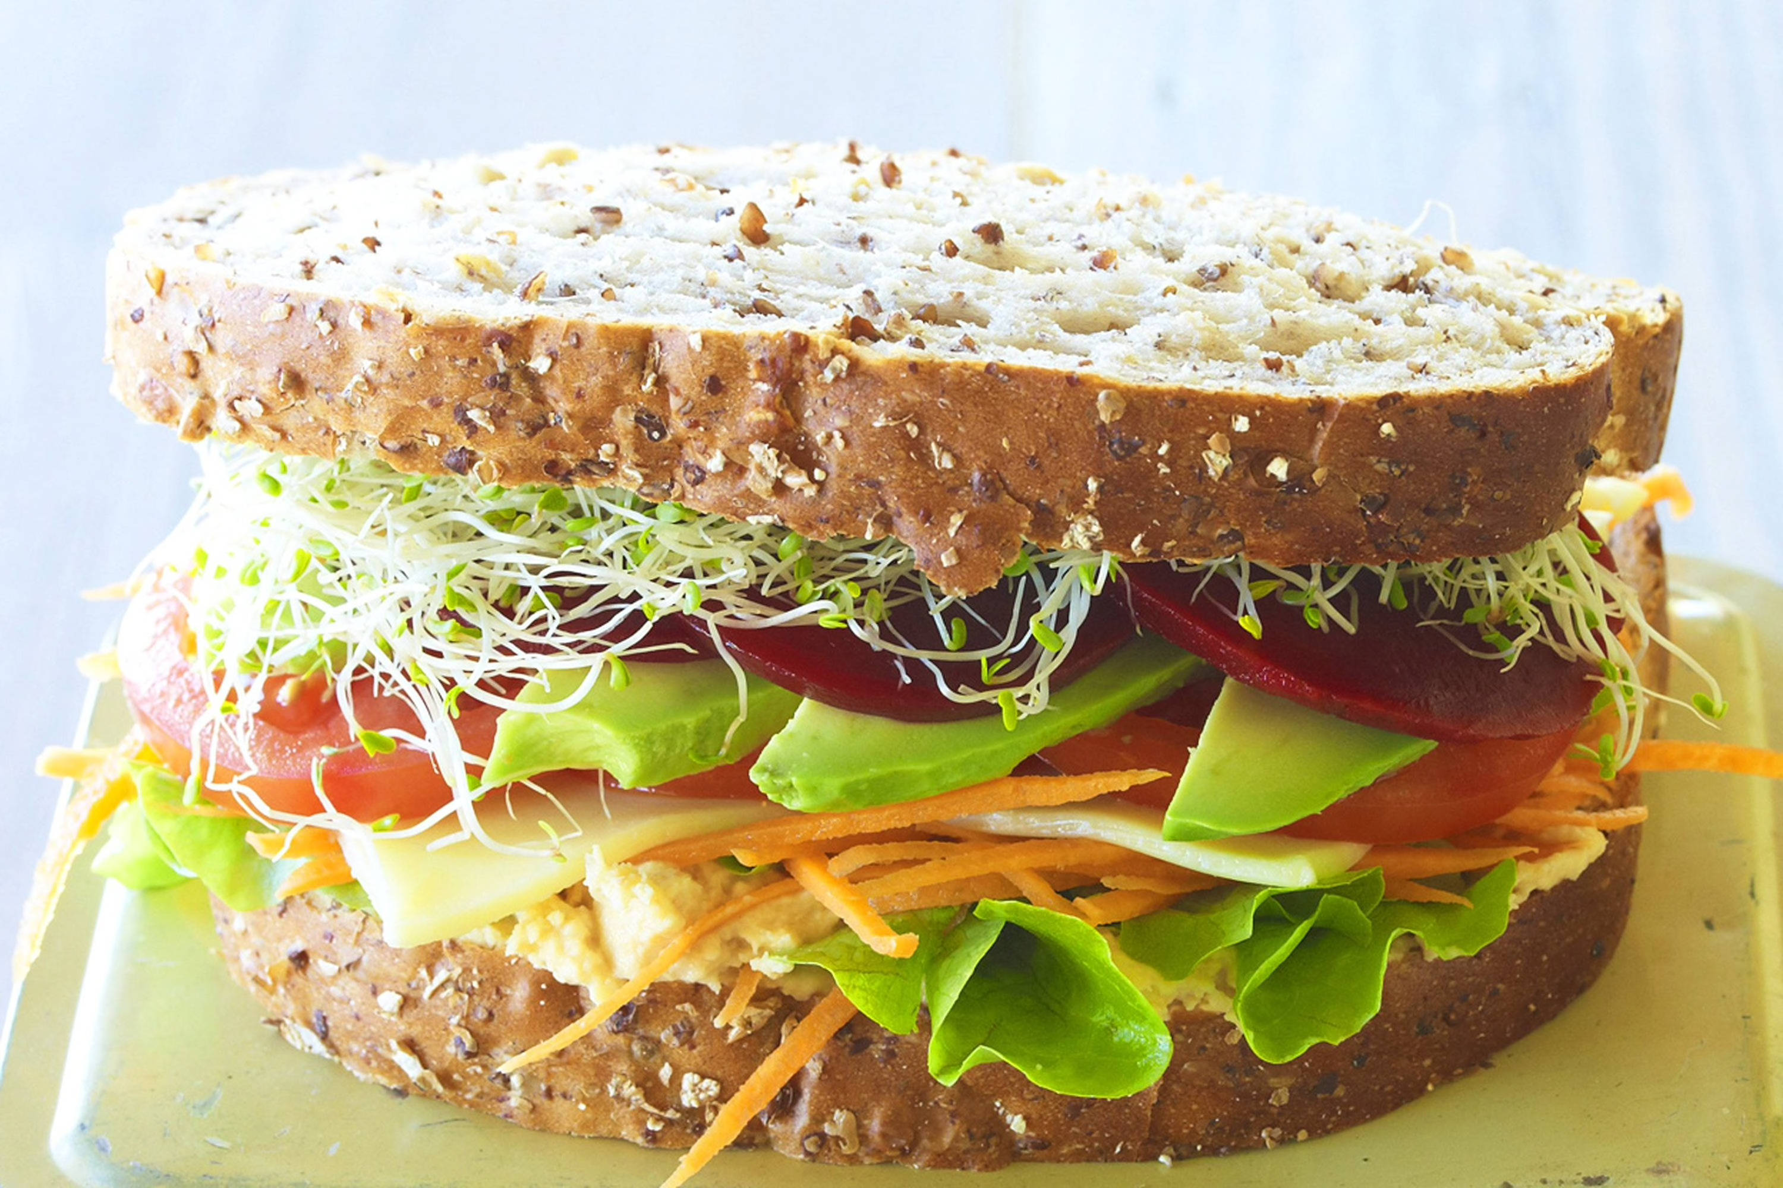
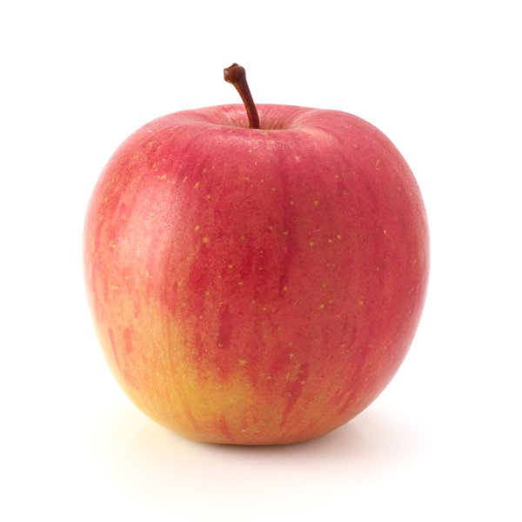


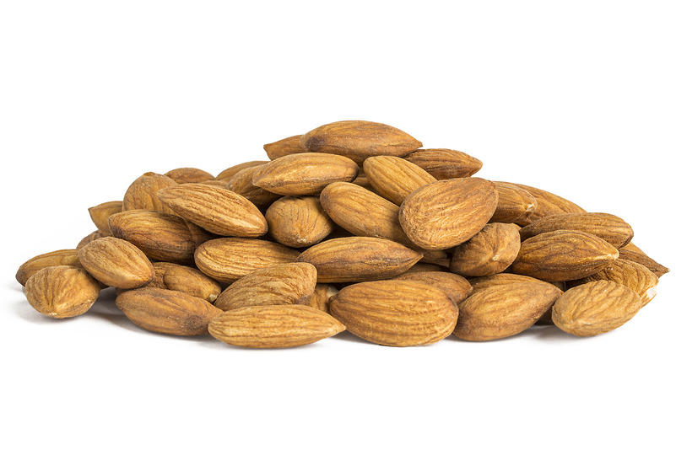
School days
Organisation and preparation the night before is key:
Recess Lunch Afternoon tea

Slide 23
School days – set yourself up for success
Use leftover meat/meat alternatives in sandwiches/wraps the next day (cook extra)
Use leftover salads in sandwiches/wraps the next day
Keep the cupboard stocked with non-perishables such as mini packets of popcorn, pretzels, sakatas, boxes of muesli bars, packets of nuts, crackers (vita weats, ryvitas)
Keep the fridge stocked with yoghurts, sliced cheese and pre-cut fruit and vegetables
Keep a fruit bowl stocked on the bench
Decide the night before what will be recess snacks and what will be afternoon tea snacks

Slide 24
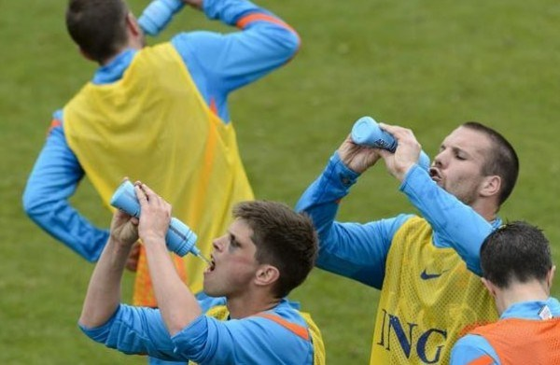
Hydration
Why is it important?

Slide 25
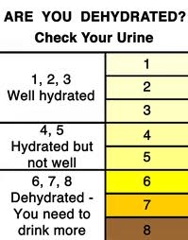
Hydration

Slide 26




Remembering to drink
Water jug in the fridge
Water jug on the bench
Large bottle at school/work
- Re-filling smaller bottle at school/work

Slide 27
Cramping?
The most agreed on cause of cramping is muscle fatigue
Research has not shown good evidence for sodium or hydration playing a role

Slide 28
Cramping?
Reduce the risk of cramp:
1. Train (be well conditioned)
2. Fuel adequately (reduce risk of muscle fatigue)
3. Hydrate adequately (reduce risk of muscle fatigue)

Slide 29

Foundation for Success
Adequate quantities

Slide 30
What is a supplement?
Examples include:
Protein powder
Ready-to-drink protein drinks
Creatine
Protein bars
Foods containing protein powder (very common these days)

Slide 31

What is a supplement?
It does not include:
Sports drink
Sports gels containing just carbohydrate
These are considered
sports foods

Slide 32
Supplements
Poorly regulated industry
Unknown safety or efficacy in children
High risk of inadvertent doping
De-emphasises more important aspects – consistent training and good diet (for example)

Slide 33
Questions? www.sportrition.com.au erica.dietitian@gmail.com

