Slide 1


Sports Podiatry
Putting your feet in trustworthy hands

Slide 2
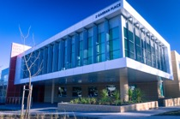
Canberra's only Sports Podiatry Clinic utilising the latest technology to assess strength and power, combined with some of the most qualified Sports Podiatrists in the country.

Slide 3

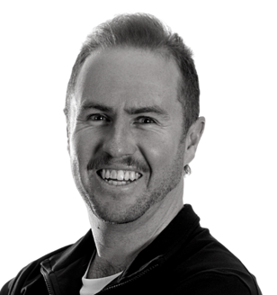
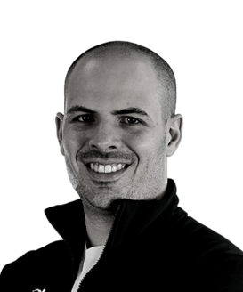
Our Team
Patrick Doan
Founder, Podiatrist, High Performance Consultant, Strength and Conditioning Coach
Kyle Dedini
Founder, Podiatrist
Alex Murray
Senior Podiatrist, Strength and Conditioning Coach

Slide 4
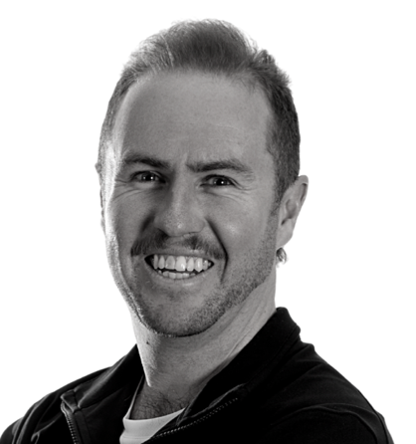
Our Team
Kyle Dedini
      Bachelor of Podiatry – Charles Sturt University (2012)
      ASCA Level 0 Strength & Conditioning Coach
      Previous State (TAS) Board Member for Sports Medicine Australia (3 years)
      Recipient of $30,000 in academic scholarships
      Previous NPL 1 player (Kingsborough Lions, TAS)

Slide 5

Our Team
Patrick Doan
      Bachelor of Podiatry – Charles Sturt University (2014)
      Masters of High-Performance Sport – Australian Catholic University (2018)
      Accredited ESSA Exercise Sports Scientist Level 2 (ASpS2)
      Accredited ESSA Exercise Scientist (AES)
      ASCA PCAS Professional Strength & Conditioning Coach
      ASCA Level 2 Strength & Conditioning Coach

Slide 6

Our Team
Alex Murray
      Bachelor of Health Science – La Trobe University (2013)
      Master of Podiatry Practice – La Trobe University (2013)
      Post-Graduate Diploma in Sports and Exercise Medicine (awarded with Distinction)
        [Study focus: Special Populations (Paediatrics), Women in Sport, Lower Limb Musculoskeletal Medicine, Exercise Prescription] University of Otago (2017)
      ASCA Level 1 Strength & Conditioning Coach
      Lecturer – Sports Podiatry and Musculoskeletal Medicine – Podiatry Systems

Slide 7
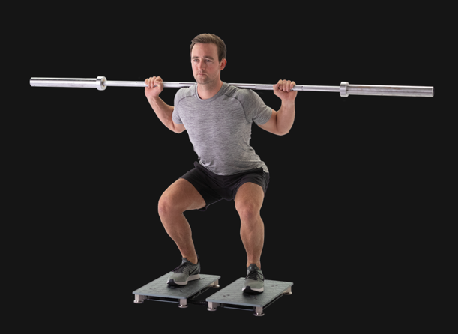

Our Equipment
VALD Performance Force Decks
Analyse balance, strength and movement strategies in a range of
exercises and jumps
Provide information to provide most accurate injury analysis and return to play programs
Used EPL and UEFA clubs

Slide 8
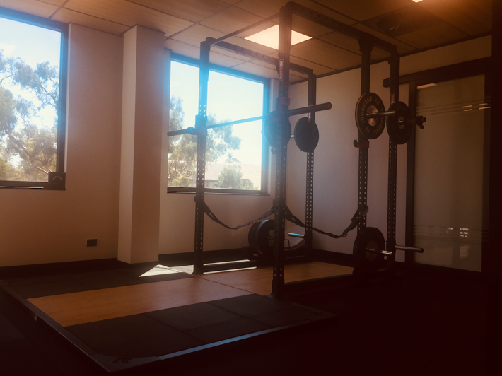
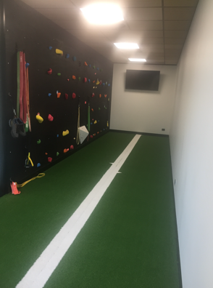
Our Equipment
Full Gym including:
Iron Edge Olympic Squat Rack
Sled Track
Bouldering Wall

Slide 9
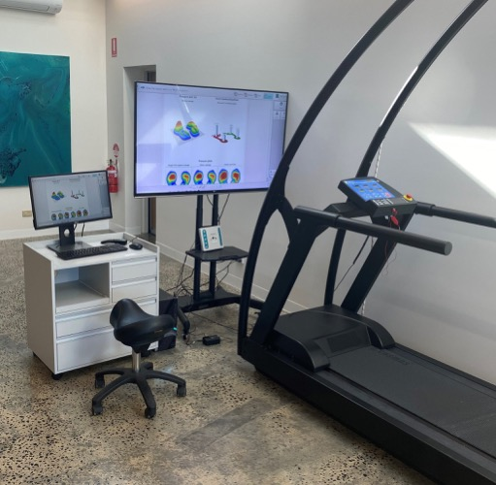
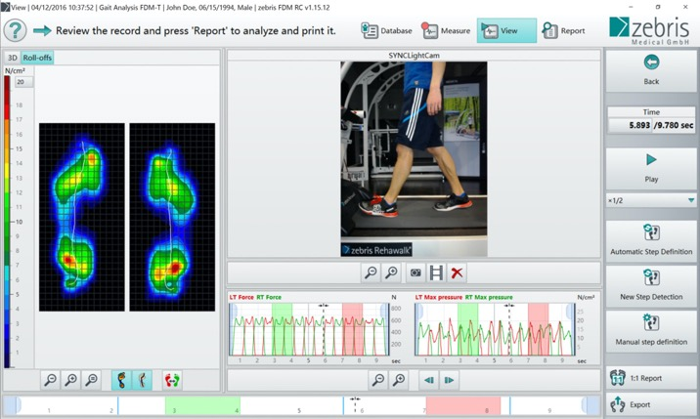
Our Equipment
Zebris Dynamic Pressure Treadmill (Coming end of 2021)

Slide 10
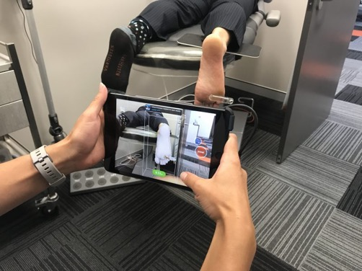
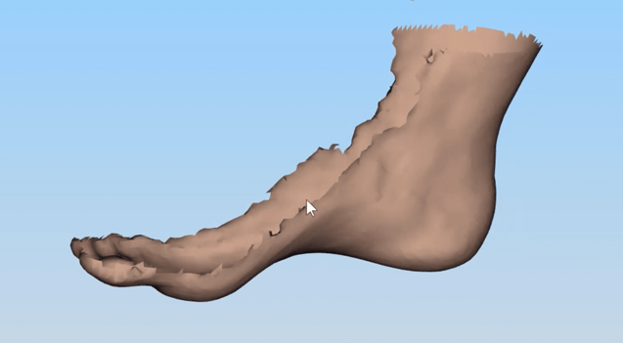
Our Equipment
3D Scanning/Printing of Foot Orthoses

Slide 11

What can do Podiatrists do for Footballers?
Common Lower Limb Injuries
Load Management
Strength and Conditioning
  Intrinsic Foot Strength
Football Boots
Blisters
Ingrown Nails

Slide 12
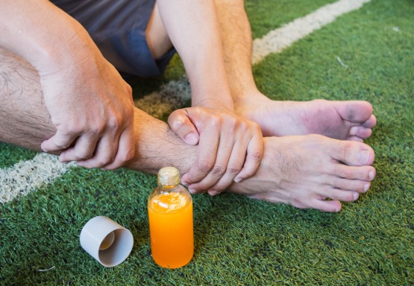
Common Injuries
  Ankle Sprains
    High (Syndesmosis)
    Low (Ankle)
  Tendon Injuries
    Achilles
    Inside/Outside Ankle
  Shin Splints
  Bone Injuries
    Stress injuries/fractures

Slide 13
Common Injuries
  Knee
    Front of knee pain
    Growth plate injuries
  Hip
    Glute pain

Slide 14
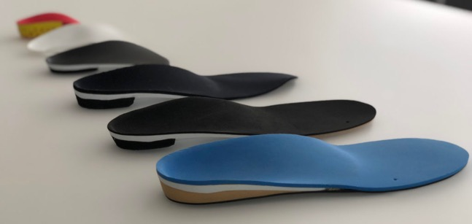
Load Management
  Training Plan Modification
    Periodisation Training
    Recovery periods
  2nd Shoe method
  Custom and Pre-fabricated Foot Orthotics
  Recovery Methods
    Pool sessions, ice bath etc

Slide 15
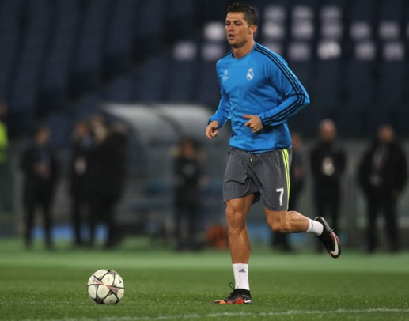
Strength and Conditioning
  Training Plan Guidance
  Return to performance
  Intrinsic Foot Strengthening

Slide 16
Intrinsic Foot Strengthening
activation & strength of the three largest intrinsic foot muscles will reduce arch from flattening
When the intrinsic foot muscles are activated they can increase their response to increasing vertical load.
While running the foot absorbed energy when you hit the ground subsequently returns less energy generated as you push off. The stronger your strength/activation of the arch muscles you can conserve more energy at higher running speeds.

Slide 17
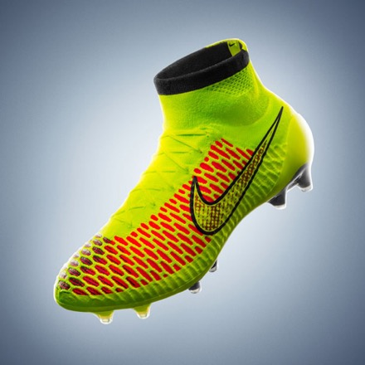
Football Boot Considerations
  Materials
  Shank
  Stud Pattern/Stud Type
  Heel Pitch (Low/High)
  In-Built Sock Upper

Slide 18
Football Boot Considerations
  Materials
    Calf Leather
    Kangaroo Leather
    Synthetic
  Shank
  Stud Pattern/Stud Type
  Heel Pitch (Low/High)
  In-Built Sock Upper

Slide 19
Football Boot Considerations
  Materials
  Shank
  Stud Pattern/Stud Type
  Heel Pitch (Low/High)
  In-Built Sock Upper

Slide 20
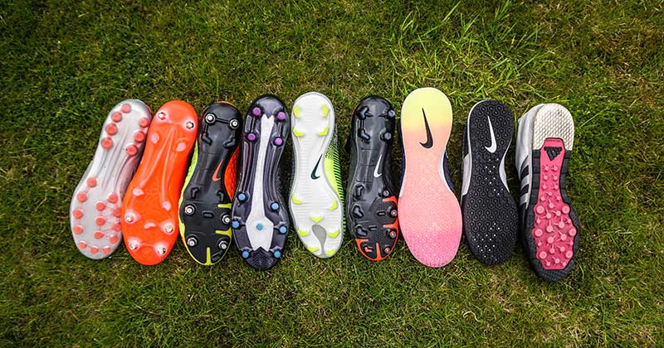
Football Boot Considerations
  Materials
  Shank
  Stud Pattern/Stud Type
  Heel Pitch (Low/High)
  In-Built Sock Upper

Slide 21
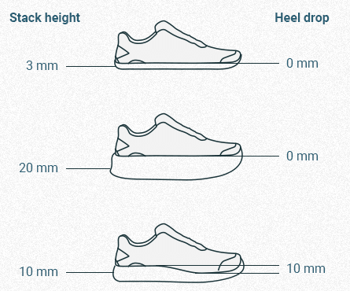
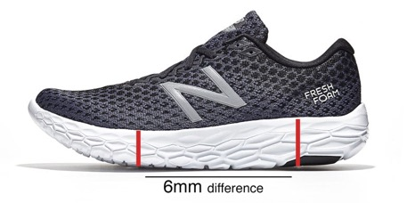
Football Boot Considerations
  Materials
  Shank
  Stud Pattern/Stud Type
  Heel Pitch (Low/High)
  In-Built Sock Upper

Slide 22
Football Boot Considerations
  Materials
  Shank
  Stud Pattern/Stud Type
  Heel Pitch (Low/High)
  In-Built Sock Upper

Slide 23
QUESTIONS?

Slide 24

Proactive Performance / Canberra Foot and Ankle Clinic - GARRAN
Canberra Foot and Ankle Clinic - CASEY
Suite 12, 2 Garran Place, Garran, ACT, 2605
02 6147 5738
Admin@proactiveperformance.com.au
Inside Ochre Health Casey, 15 Whitrod Ave, Casey, ACT, 2913
02 6163 4200
Admin@canberrafootandankleclinic.com.au
Proactive Performance - Dickson
Located inside Sportscare, Unit 2, 55 Woolley St, Dickson, ACT, 2602
02 6147 5738
Admin@proactiveperformance.com.au

